Slide 1

Welcome to Information & Application Night
All participants microphones are muted to reduce sound interference during the presentation.
Please submit your questions through the chat feature at the bottom of the screen. An AMCS staff member will read the question at the end of the presentation during the Q&A session.
asdk12.org/amcs
Notes:
Kern - please advise

Slide 2
What is Alaska Middle College School? (AMCS)
Is a collaboration between ASD and UAA
AMCS is a dual enrollment program located on King Tech High School and UAA Campus
Goals
  Transition support for students completing college credit while still in high school & meeting graduation requirements
Outcomes
  Primary Outcome: Completion of high school diploma requirements using a combination of college and high school credits
  Secondary Outcome: Completion of college course credits
    Potential to earn a UAA Associate of Arts Degree or certificate
Notes:
Kim
What is Alaska Middle College School?
Alaska Middle College School is a collaboration between University of Alaska Anchorage and ASD. It is a program that requires students to be dually enrolled, or at the sametime, in ASD and UAA. A dual enrollment program means the student is associated associated with two different sets of policies and procedures. It is very much like dual citizenship in which a person can hold citizenship in America and Canada. You have the privilege and benefits from both countries, but you must abide by both countries' laws and processes.
The goal of the program is to provide transition support for students completing college credits for their high diploma requirements while still in high school.
The primary outcome of this program is to ensure all students graduate on time. We also want students to complete college courses and earn credits towards their personal or academic goals. Please note, earning an Associate of Arts degree is possible, however it is difficult to complete in 4 semester. You will need to take 15 credits per semester.

Slide 3
Who should consider applying?
  ASD Juniors and Seniors (fall) who are:
Ready to step into a college environment
Ready to accept college-level independence
Qualify to take college-level math and/or writing
What does ready mean?
Shows academic preparedness
Maintains strong attendance record
Demonstrates maturity, responsibility & independence
Notes:
Kim
Who should consider applying to AMCS?
This is a program for juniors and seniors only. Students need to be ready for a fast-learning environment, be able to work independently, manage their time, and demonstrate academic readiness. Academic readiness means students must complete placement testing with UAA for writing and math. To qualify for the program, students scores must place them into college writing and math.
Are you ready?
Student must have strong attendance records at their school. Missing just one class can be detrimental to the student’s success in the course because college courses move through more materials in semester than what is found in high school semester course. College courses usually cover a year’s worth of material in one semester. Also, college courses do not meet every day but one, twice or three times a week. So it is imperative students manage their time wisely. Since students will be in an adult environment, students in AMCS must be mature, responsible and independent. We will not manage your time, we will not remind you to complete your homework. Your parents should not have to do this for you. You must be able to do this yourself.

Slide 4
Who Covers the Cost?
  Anchorage School District pays for
    UAA Tuition, Fees, and books
    Bus Transportation (when budget/staffing allows)
    High School Staff
ASD does not pay for:
    Personal use items (lab goggles, lab coats, etc.)
    Internet
    UAA parking Permit
    Summer courses and certain elective courses (student is responsible for all costs)
Notes:
Kim
The ASD covers most of the costs for you to participate in the AMCS program. However, there are some costs you will need to plan to cover. ASD will cover all UAA tuition and fees for approved courses along with all textbooks related to those courses. ASD will supply a Chromebook if you need one. ASD provides transportation as needed and covers all the costs for the AMCS employees.
Students will need to plan to pay for personal items that cannot be shared or reused. Such items would be personal safety equipment like lab goggles, lab coats, scrubs, etc. Students are also expected to cover study materials such as paper, pencils, notebooks, calculators, etc along with Internet costs.
Please note, ASD cost are only for the fall and spring semester. If a student wants to enroll at the University for summer courses, all costs are the responsibility of the student, ASD will not pay the bill. Also, ASD will not pay for certain courses as they are cost prohibitive, such as the Profession Piloting Class which has a $5,000 lab fee.

Slide 5
High School Primary v. Affiliate Enrollment
Degree: AMCS is primary enrollment:
  Diploma issued from AMCS
  Honor Grad status through AMCS
  Assigned counselor through AMCS
  Yearbook Staff
  Graduation ceremony
Certificate: Affiliate is primary
  Diploma issued from affiliate school
  Honor Grad status through affiliate school
  No Assigned counselor through AMCS
Notes:
Beth
Once you enroll in Alaska Middle College School, AMCS becomes your primary school. If you’re transferring to us from an ASD school, that school will become your affiliate school. If you’re new to the Anchorage School District, the high school that is in your zone based on your address becomes your affiliate school.

Slide 6
High School Primary v. Affiliate Enrollment
Students can maintain involvement with affiliate school (some limitations):
  Single course enrollment (degree programs)
    Theater
    Choir
    Immersion
    ROTC
  Student life activities
    Athletics
    Prom/dances
  Graduation ceremony
    Degree: may walk at affiliate high school graduation
Notes:
Beth
Once you enroll in Alaska Middle College School, AMCS becomes your primary school. If you’re transferring to us from an ASD school, that school will become your affiliate school. If you’re new to the Anchorage School District, the high school that is in your zone based on your address becomes your affiliate school.

Slide 7
Can students still play sports?
  Students can participate in athletics at their affiliate high school
  All ASAA athletic eligibility rules apply
  Student must take a full schedule, the equivalent of 3.0 high school credits each semester.
  Athletic eligibility is only determined on a semester basis through AMCS
    Student cannot regain athletic eligibility at the quarter because UAA does not issue quarter grades
Notes:
Beth
An athlete must be enrolled in the equivalent of five semester-long classes (2.5 credits) to maintain athletic eligibility;

Slide 8
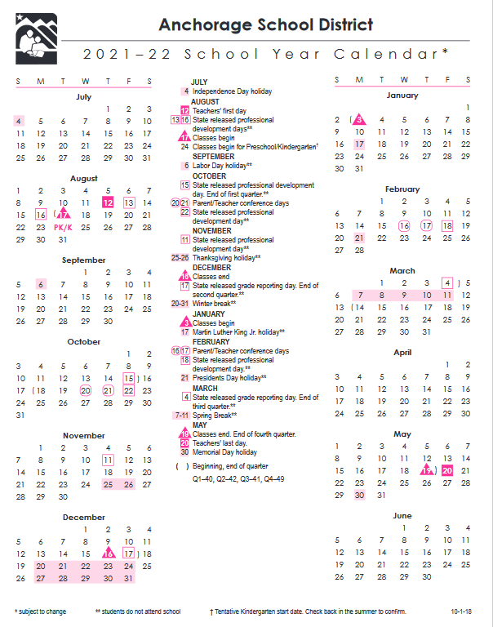
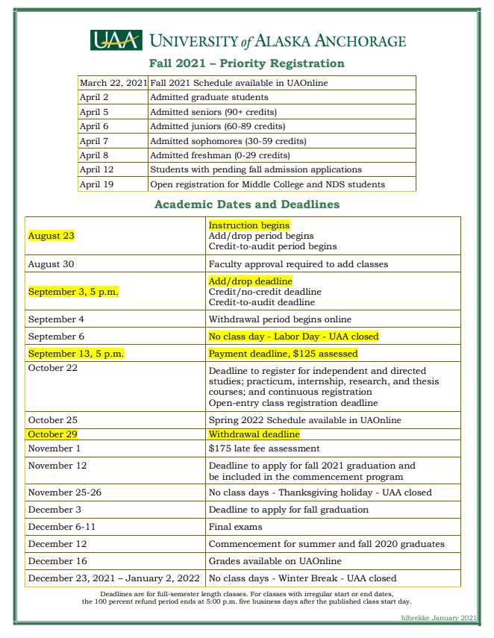
Dual Enrollment
ASD and UAA
AMCS students are both ASD & UAA students. They follow:
  ASD Calendar
  UAA Calendar
  UAA Student Handbook
  ASD Student Handbook
  UAA Student Code of Conduct
  ASD Student Code of Conduct
  Examples: In-Service Days & Closure Days
Notes:
Kim
As stated previously, you are a dual citizenship in both ASD and UAA. This means you will follow the UAA and ASD calendars, handbooks and student code of conduct. You are responsible for being aware of the holidays breaks, closures, class times, etc. for each entity. Beware ASD and UAA each have different days such as ASD’s in-service days, parent/teacher conferences and holidays. An example is that ASD has president day off but UAA does not observe this holiday. If the you have a college course scheduled for a Mondays, you will need to attend the class. Also, beware ASD and UAA do not alway close together. ASD can close for icy sidewalks and icy bus routes but UAA may stay open.
If you have questions about these areas, please direct your questions to the appropriate staff. High school to ASD AMCS staff and College and UAA questions to the college advisors.

Slide 9
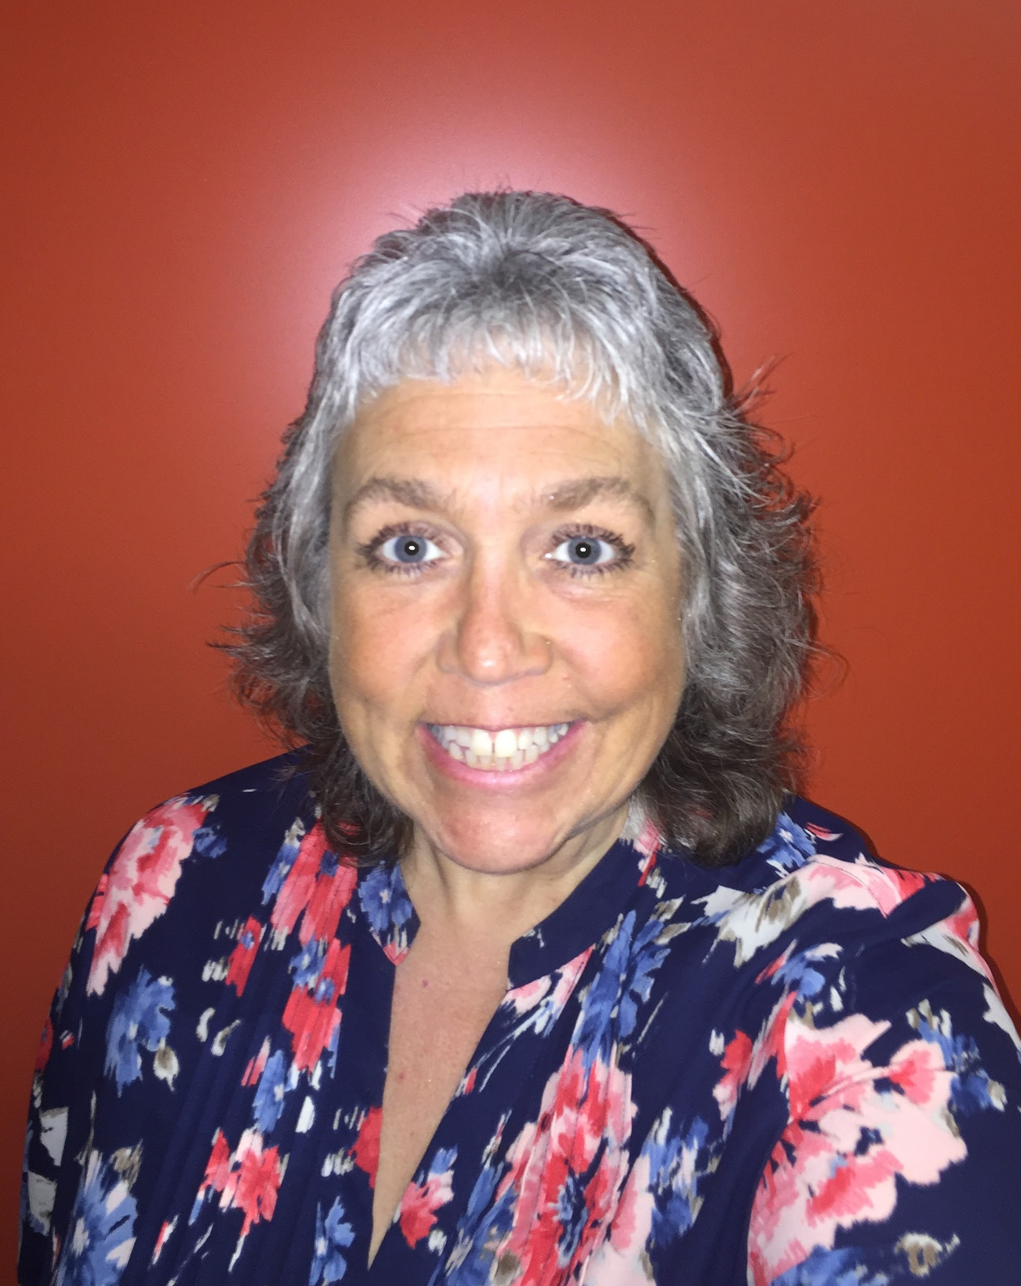
UAA Advising
Once students have been formally accepted,
they should email a UAA Middle College Advisor to schedule an hour-long appointment
Middle College Advisor
Heather Brekke
hlbrekke@alaska.edu
Notes:
Heather

Slide 10
Transfer Credits
Transferability of credits is determined by accepting university
  Middle College advisor works with students to align courses
Important to keep a copy of all UAA course syllabi for your records
First Year Freshmen or Transfer Student?
To look at transfer credit
The University of Alaska Anchorage has been accredited by the Northwest Commission on Colleges and Universities (NWCCU) since 1974.
Notes:
Heather
The University of Alaska Anchorage has been accredited by the Northwest Commission on Colleges and Universities (NWCCU) since 1974.

Slide 11
Activities at UAA
Middle College students are permitted to participate in university clubs, sports, and activities when they turn 18, they can participate in some activities before they are 18 years old
Middle College students can work on campus as student worker when they turn 18 years old
Campus Safety
Always use caution and follow university safety guidelines
AMCS students are in classes with the normal university population
Students should report any unwanted, inappropriate, or questionable behaviors to a Middle College staff member
Study groups should take place on campus or online
Notes:
Heather

Slide 12
Schedule: College - Degree
 | MONDAY | TUESDAY | WEDNESDAY | THURSDAY | FRIDAY
8:30 am – 9:45 am | WRTG A111 Distance Blackboard
10:00 am – 11:15 am |  | MATH A151 RH 211 |  | MATH A151 RH 211
11:30 am – 12:45 pm
1:00 pm – 2:15 pm |  | UNIV A150 Distance WEB
2:30 pm – 3:45 pm
Notes:
Heather

Slide 13
Schedule: College + High School
 | MONDAY | TUESDAY | WEDNESDAY | THURSDAY | FRIDAY
8:30 am – 9:45 am | WRTG A111 Distance Blackboard
10:00 am – 11:15 am |  | MATH A151 RH 211 |  | MATH A151 RH 211
11:30 am – 12:45 pm |  | LA Advisory
1:00 pm – 2:15 pm |  | UNIV A150 Distance WEB | Math Advisory
2:30 pm – 3:45 pm
Notes:
Beth
The AMCS school counselor will review the schedule you created with your UAA advisor to make sure you’re meeting ASD’s graduation requirements. Your AMCS counselor will also work with you to schedule advisory classes and any other classes that need to be taken through AMCS or any other ASD program.

Slide 14
Schedule: College + High School + Affiliate School
 | MONDAY | TUESDAY | WEDNESDAY | THURSDAY | FRIDAY
8:30 am – 9:45 am | Orchestra | Orchestra |  | Orchestra | Orchestra
10:00 am – 11:15 am |  | MATH A151 RH 211 |  | MATH A151 RH 211
11:30 am – 12:45 pm | WRTG A111 Distance Blackboard | LA Advisory
1:00 pm – 2:15 pm |  | UNIV A150 DIST WEB | Math Advisory
2:30 pm – 3:45 pm
Notes:
Beth -In addition to the advisory classes, some students will request to take a class at their affiliate school.
Students who wish to take a class at their affiliate school, for example, music or a foreign language need to fill out a single course enrollment forms. These forms are available on the AMCS website. They need to be completed and returned to your AMCS counselor who will forward it to the principal for administrative approval.
Single course enrollment forms are typically due two weeks before the end of the semester prior to the semester in which you want to take the class. Students who are entering AMCS for the first time will be given some flexibility, however, keep in mind that the affiliate school will have drops and adds deadlines that we might not be aware of so it’s best to turn them in early.
As you can see from this slide, Single Course Enrollments aren’t guaranteed. Our priority is for you to earn college credits. In fact, you can take classes such as foreign language, music, and art at UAA. If, however, you want to take a class at your affiliate school, make sure to let your UAA advisor know so that it can be taken into consideration when you’re building your UAA schedule.
• AMCS Students may request to take one course at their affiliate school.
• Single course enrollments can be difficult to schedule and are often not possible.
• College courses and advisories will take scheduling priority over single course enrollments.
• To be approved, the requested course must not conflict with any other scheduled courses on any day of the week.
• If a student withdraws from or earns a grade of D or F in a college class, a single course enrollment will not be permitted the following semester.
• AMCS students are encouraged to take foreign languages, music, art, and other elective classes through UAA rather than as single course enrollments.

Slide 15
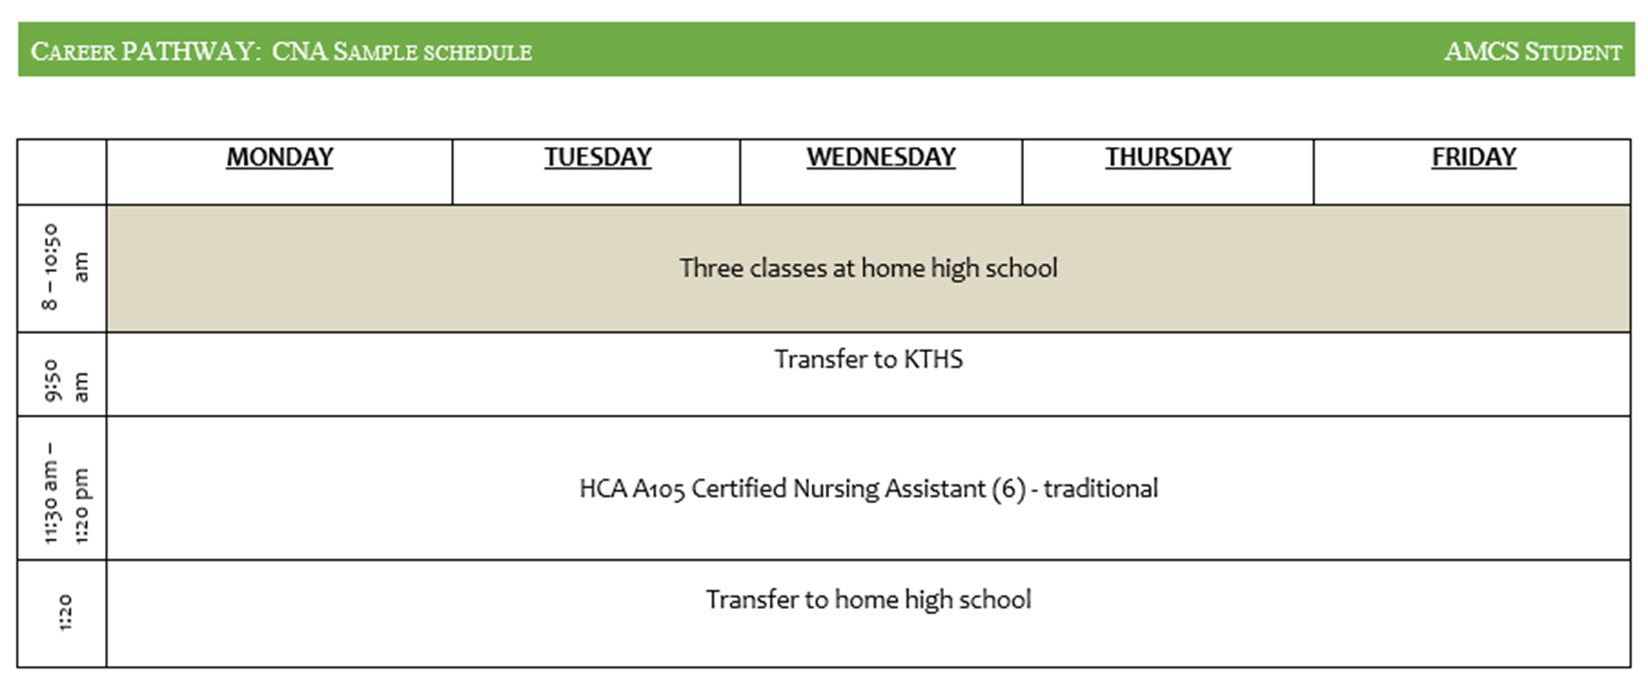
Schedule: College - Certificate + High School
Notes:
Heather

Slide 16
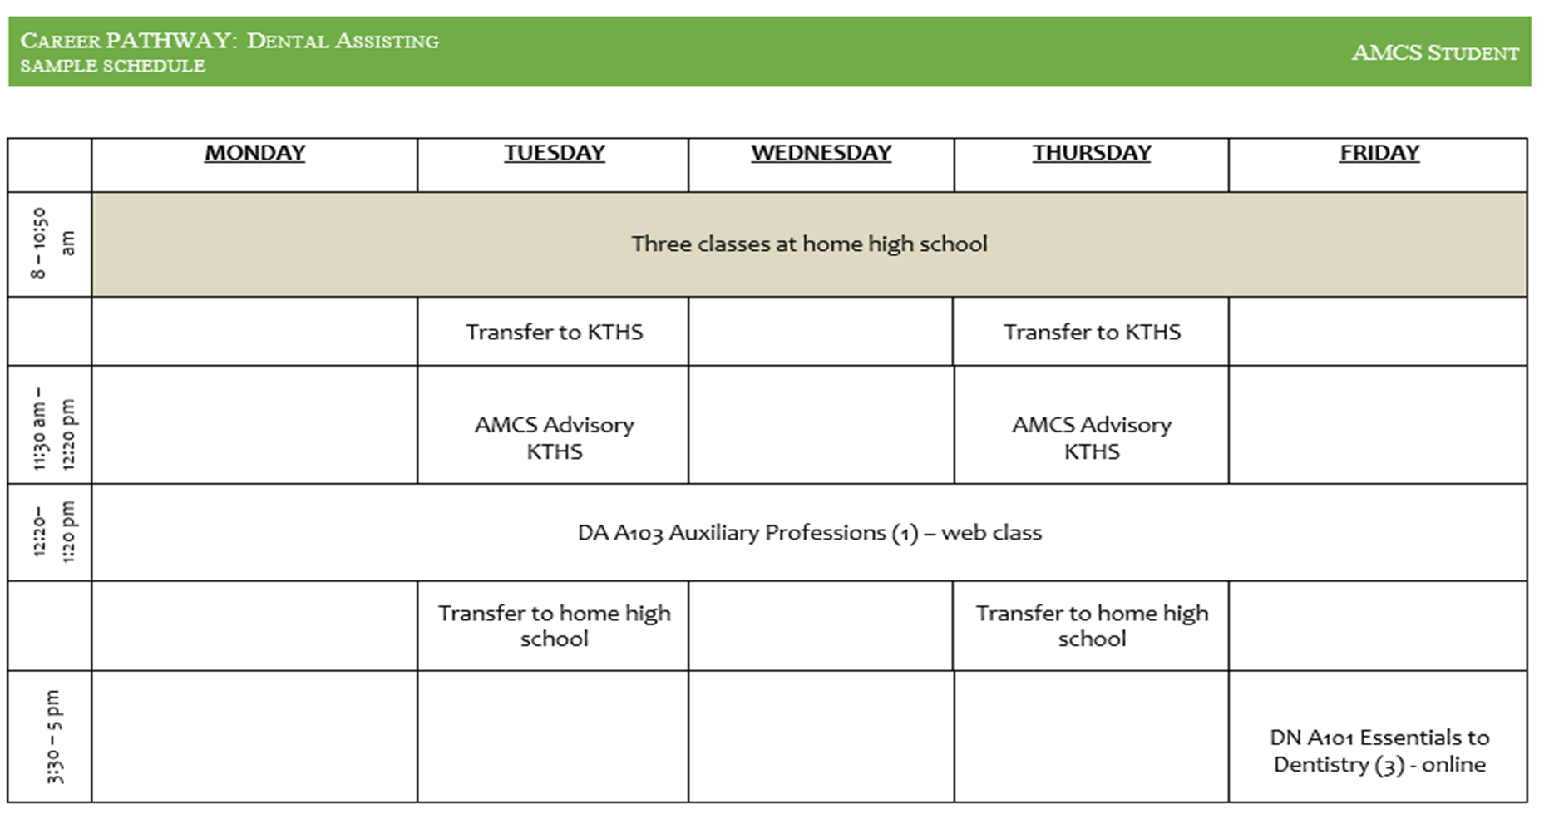
Schedule: College + High School
Notes:
Beth
The AMCS school counselor will review the schedule you created with your UAA advisor to make sure you’re meeting ASD’s graduation requirements. Your AMCS counselor will also work with you to schedule advisory classes and any other classes that need to be taken through AMCS or any other ASD program.

Slide 17
What are the Science, LA & Math Advisories?
High school support for college enrollment
Attendance is required first semester, subsequently may be required based on college grades
Credit class – .5 elective credit
Course expectations are determined by the instructor.
Pass/fail
Dedicated space to complete college work
Academic support by certificated ASD teacher
Notes:
Beth
-Advisory classes are designed to provide students with extra support as they acclimate to college classes. Advisory teachers not only help with homework, but they also help students navigate being dual-enrolled in ASD and UAA. They provide direction and advice as needed. For example, how to communicate with your professor.
Advisory classes are required during the semesters in which you take your first UAA Language Arts and Math classes. Students will be placed in advisory if they have a C or lower in a UAA math, Lang. Arts., and sometimes Science or other classes which will be determined on a case-by-case basis. Some students request to take advisory because they want to continue getting extra support.

Slide 18
What are the Junior and Senior Seminars?
Junior seminar
  Career exploration and career identification
    education requirements
    Identify top three universities/colleges
      Schedule visits in the summer
    Financial Planning
      Identifying scholarships
Senior seminar
  Submitting college and scholarship applications
  Prepare for financial aid application

Slide 19
How do we determine full-time status ?
A student must be full-time means the student is enrolled in three (9-college credits) college classes which equals 3 high school credits.
Credit issued by college | Credit equivalency for ASD
1-2 college credit course | .5 ASD credit
3-4 college credit course (most courses) | 1.0 ASD credit
5-6 college credit course | 1.5 ASD credit
College Course | College Credits | High School Requirement | High School Credits
HIST A131 OR A132 | 3 | US History | 1
WRTG A111 | 3 | ENGLISH III or IV | 1
PS A101 OR A102 | 3 | US Government SS Elective | .5 .5
Notes:
Beth
AMCS students are expected to be full-time students. That means the student needs to earn a min. of 3.0 credits every semester. In a traditional high school setting, that equals six, semester-long classes. At AMCS that might equal 3 UAA classes per semester or a combination of UAA and ASD classes. Basically a 3-4 college credit course equals one high school credit which you can see on the table above. This is something that your AMCS counselor looks for when reviewing the schedules you build with your UAA advisor.

Slide 20
Application Process
Communication: Email!
Step 1: Complete applications and set UAA password
For instructions on how to apply go to AMCS and UAA, https://www.asdk12.org/Page/16147
Step 2: Complete placement tests and UAA Student/Parent Agreement form
Test are proctored and you must register to take each test
Step 3: Application Review and Notice of Invite via of Email
Step 4: Advising appointments and Orientation
Watch Induction Video and schedule appointment with UAA advisor
Attend student orientation (week before first day of college classes)
Notes:
https://asdk12.zoom.us/j/8761924969?pwd=cjNkQjh2bzI0MU5wZ21ZR2dmOFIrZz09
https://uaonline.alaska.edu/banprod/owa/bwskalog.p_disploginnew?in_id=&cpbl=&newid=

Slide 21

Help us spread the word about AMCS...
Tell all your friends, relatives, coworkers, or anyone else you think would benefit from this awesome opportunity!
Notes:
Kim

Slide 22
Questions?
Notes:
Everyone

